Slide 1
Chapter 1: Introduction
What Operating Systems Do
Computer-System Organization
Computer-System Architecture
Operating-System Structure
Operating-System Operations
Distributed Systems
Computing Environments

Slide 2
What is an Operating System?
A program that acts as an intermediary between a user of a computer and the computer hardware.
Operating system goals:
  Execute user programs and make solving user problems easier.
  Make the computer system convenient to use.

Slide 3
Computer System Structure
Computer system can be divided into four components
  Hardware – provides basic computing resources
    CPU, memory, I/O devices
  Operating system
    Controls and coordinates use of hardware among various applications and users
  Application programs – define the ways in which the system resources are used to solve the computing problems of the users
    Word processors, compilers, web browsers, database systems, video games
  Users
    People, machines, other computers

Slide 4

Four Components of a Computer System

Slide 5
OS from User View
The user view of the computer varies by the interface being used.
For the users of personal computer, the operating system is designed mostly for ease of user, with some attention paid to performance and none paid to resource utilization. In this case performance is important to the user but it does not matter if most of the system is sitting idle, waiting for the slow I/O speed of the user.
The users that are connected to mainframe or mini computer, share resources and may exchange information. For them the OS is designed to maximize resource utilization----to assure that all available CPU time, memory and I/O are used efficiently and that no individual user takes more than her fair share.
Operating System Concepts

Slide 6
Continue….
The users who sit at workstations, connected to network of other workstations and servers, have dedicated resources at their disposal but they also share resources such as networking and servers---file, print server etc.
  Therefore, their operating system is designed to compromise between individual usability and resource utilization.
Operating System Concepts

Slide 7
Operating System from System View
From the computer’s point of view, the operating system is the program that is most intimate with the hardware.
We can view OS as:
Resource allocator – manages and allocates resources.
Control program – controls the execution of user programs and operations of I/O devices .
Operating System Concepts

Slide 8
Operating System Definition
No universally accepted definition
“The one program running at all times on the computer” is the operating system (kernel). Everything else is either a system program (ships with the operating system) or an application program
Operating System exists because they offer a reasonable way to solve the problem of creating a usable computing system.
  OS is a resource allocator
    Manages all resources
    Decides between conflicting requests for efficient and fair resource use
  OS is a control program
    Controls execution of programs to prevent errors and improper use of the computer

Slide 9
Operating System Definition (Cont.)
The matter of what constitute an operating system has become increasingly important.
  In 1998, the United States Department of Justice filed suit against Microsoft, in essence claiming that Microsoft includes too much functionality in its operating systems and thus prevented application vendors from competing.

Slide 10
Operating System Generations
Generation 1 (1945 – 55)
Vacuum tubes and plugboards
Generation 2 (1955 – 65)
Transistors and batch systems
Generation 3 (1965 – 80)
ICs and multiprogramming
Generation 4 (1980 – Present)
Personal computers
Operating System Concepts

Slide 11
The first generation OS ( Vacuum Tubes and Plugboards)
Around the mid 1940s, Howard Aiken at Harvard, John von Neumann at Princeton and many other scientists succeeded in building calculating engines using vacuum tubes.
These machines were enormous, filling up entire rooms with tens of thousands of vacuum tubes but were much slower than even the cheapest personal computer available today.
In these early days, a single group of people designed, built, programmed, operated and maintained each machine.
All programming was done in absolute machine language, often by wiring up plugboards to control the machine’s basic functions.
Programming languages were unknown, OS were unheard of .
Operating System Concepts

Slide 12
Continue…
The usual mode of operation was for the programmer to sign up for block of time on the signup sheet on the wall, then come down to the machine room, insert his plugboard into the computer and spend the next few hours hoping that none of the 20,000 or so vacuum tubes would burn out during the run.
Virtually all the problems were straightforward numerical calculations.
By the early 1950s, the routine had improved somewhat with the introduction of punched cards. It was now possible to write programs on cards and read them in, instead of using plugboards; otherwise the procedure was the same
Operating System Concepts

Slide 13
Second Generation (Transistors and Batch System)
The introduction of transistor in the mid-1950s changed the picture radically.
For the first time there was a clear separation between designers, builders, operators, programmers and maintenance personnel.
These machines were locked away in specially air conditioned computer rooms with staffs of professional operators to run them. Only big corporations or major government agencies or universities could afford the multimillion dollar price tag.
To run a job (a program or a set of programs), a programmer would first write the program on paper (in FORTRAN or assembler), then punch it on the cards.
He would then bring the card deck down to the input room and hand it to one of the operators.
Operating System Concepts

Slide 14
Continue…
When the computer finished whatever job it was currently running, an operator would go over to the printer and tear off the output and carry it over to the output room, so that the programmer could collect it later.
Then he would take one of the card decks that had been brought from the input room and read it in.
If the FORTRAN compiler was needed, the operator would have to get it from a file cabinet and read it in.
Much computer time was wasted while operators were walking around the machine room.
The solution generally adopted was the batch system.
Operating System Concepts

Slide 15
Continue..
The idea behind was to collect a tray full of jobs in the input room and then read them onto a magnetic tape using a small, inexpensive computer such as IBM 1401, which was very good at reading cards, copying tapes and printing output but not at all good at numerical calculations.
Other much more expensive machines, such as the IBM 7094, were used for the real computing.
After about an hour of collecting a batch of jobs, the tape was rewound and brought into the machine room, where it was mounted on a tape drive.
The operator then loaded a special program(the ancestor of today’s OS), which read the first job from tape and ran it.
The output was written onto a second tape, instead of being printed.
Operating System Concepts

Slide 16
Continue…
After each job finished, the OS automatically read the next job form the tape and began running it.
When the whole batch was done, the operator removed the input and output tapes, replaced the input tape with the next batch and brought the output tape to a 1401 for printing off line.
Operating System Concepts

Slide 17

Early Batch System (1)
Figure 1-2. An early batch system. (a) Programmers bring cards to 1401. (b)1401 reads batch of jobs onto tape.
Operating System Concepts

Slide 18
Early Batch System (2)
Figure 1-2. An early batch system. (c) Operator carries input tape to 7094. (d) 7094 does computing.
Operating System Concepts

Slide 19
Early Batch System (3)
Figure 1-2. An early batch system. (e) Operator carries output tape to 1401. (f) 1401 prints output.
Operating System Concepts

Slide 20
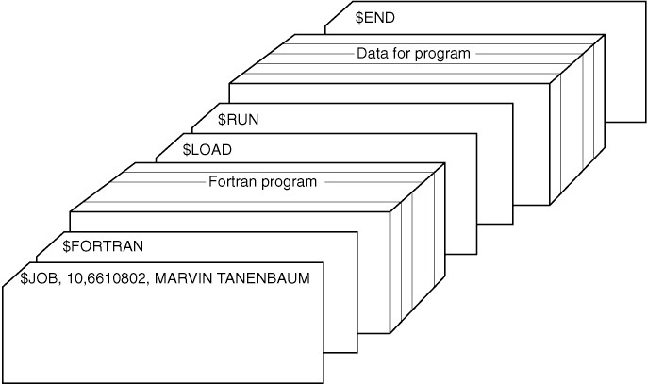
Early Batch System (4)
Figure 1-3. Structure of a typical FMS job.
Structure of a typical input job
Operating System Concepts

Slide 21
Continue…
It started out with a $JOB card, specifying the maximum run time in minutes and the programmer’s name
Then came a $FORTRAN card, telling the operating system to load the FORTRAN compiler from the system tape.
It was followed by the program to be compiled and then a $LOAD card, directing the operating system to load the object program just compiled.
Next came the $RUN card, telling the operating system to run the program with the data following it.
Finally, the $END card marked the end of the job.
Operating System Concepts

Slide 22
The Third Generation (Multiprogramming)
By the early 1960s, most computer manufacturers had two distinct and totally incompatible product lines.
  On the one hand, there were the word-oriented, large-scale scientific computers, such as 7094, which were used for numerical calculation in science and engineering.
  On the other hand, there were the character-oriented, commercial computers, such as 1401, which were widely used for tape sorting and printing by banks and insurance companies
Developing and maintaining two completely different product lines was an expensive proposition for the manufacturers.
The solution was System/360 (developed by IBM).
Operating System Concepts

Slide 23
Continue…
The 360 was a series of software-compatible machines ranging from 1401-sized to much more powerful than the 7094. The machines differed only in price and performance
Since all the machines had the same architecture and instruction set, programs written for one machine could run on all the others, at least in theory.
Furthermore, the 360 was designed to handle both scientific and commercial computing.
The 360 was the first major computer line to use ICs, thus proving a major price/performance advantage over the second-generation machines, which were built up from individual transistors.
Operating System Concepts

Slide 24
Continue….
The greatest strength of the “one family” idea was simultaneously its greatest weakness.
The intention was that all software, including the operating system, had to work on all models. But there was no way that IBM (or anybody else) could write a piece of software to meet all the conflicting requirements.
The result was an enormous and extraordinarily complex operating system.
Despite its size and problems, OS/360 and the similar third-generation operating systems produced by other computer manufacturers actually satisfied most of their customers reasonably well. They also introduced the technique “multiprogramming”
Operating System Concepts

Slide 25
Continue…
On the 7094, when the current job paused to wait for a tape or other I/O operation to complete, the CPU simply sat idle until the I/O finished.
With heavily CPU-bound scientific calculations, I/O is infrequent, so this wasted time is not significant.
The solution that evolved was partition memory into several pieces, with a different job in each partition.
While one job was waiting for I/O to complete, another job could be using the CPU.
Having multiple jobs in memory at once required special hardware to protect each job against snooping and mischief by other ones.
Operating System Concepts

Slide 26
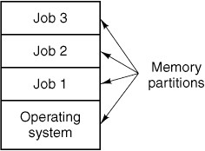
Multiprogramming
Figure 1-4. A multiprogramming system
with three jobs in memory.
Tanenbaum & Woodhull, Operating Systems: Design and Implementation, (c) 2006 Prentice-Hall, Inc. All rights reserved. 0-13-142938-8

Slide 27
Continue…
All the jobs that enter to the system are kept in the job pool. This pool consists of the processes residing on the disk, awaiting allocation of main memory.
If several jobs are ready to be brought into memory and if there is not enough room for all of them, then the system must choose among them. Making this decision is job scheduling.
If several jobs are ready to run at the same time, the system must choose among them. Making this decision is CPU Scheduling.
Operating System Concepts

Slide 28
Continue…
Another major feature present in third-generation operating system was the ability to read jobs from cards onto the disk as soon as they were brought to the computer room. Then, whenever a running job finished, the operating system could load a new job from the disk into the now-empty partition and run it. This technique is called “spooling”.
Although third-generation operating systems were well-suited for big scientific calculation and massive commercial data processing runs, they were still basically batch system.
With third-generation systems, the time between submitting a job and getting back the output was often several hours, so a single placed comma could cause a compilation to fail and the programmer to waste half a day.
Operating System Concepts

Slide 29
Continue…
This desire for quick response time paved the way for timesharing , a variant of multiprogramming where each user has an on-line terminal.
Since people debugging programs usually issue short commands rather than long ones, the computer can provide fast, interactive service to a number of users and perhaps also work on big batch jobs in the background when the CPU is otherwise idle.
The fist timesharing machine (CTSS) was developed at MIT on a specially modified 7094.
Another major development during the third generation was the phenomenal growth of minicomputers, starting with the DEC PDP-1 in 1961. The PDP-1 had only 4K of 18-bit words, but at $120,000 per machine (less than 5% of the price of 7094), they sold like hotcakes.
Operating System Concepts

Slide 30
The Fourth Generation: Personal Computer
With the development of VLSI circuits, the age of personal computer dawned. In terms of architecture, personal computers were not that different from minicomputers of the PDP-11 class but in terms of price they certainly was different.
Two operating systems initially dominated the personal computer scene: Microsoft’s MS-DOS and UNIX.
MS-DOS was widely used on the IBM PC and other machines using Intel 8088 CPU and its successors.
Although the initial version of MS-DOS was relatively primitive, subsequent versions have included more advanced features, including many taken from UNIX.
The other major contender is UNIX, which is dominant on workstations and other high-end computers, such a network servers.
Operating System Concepts

Slide 31
Continue…
An interesting development that began taking place during the mid-1980s is the growth of networks of personal computers running network operating system or distributed operating system.
Network operating systems are not fundamentally different from single-processor operating systems. They just need a NIC controller and some low-level software to drive it, as well as programs to achieve remote login and remote file access, but these additions do not change the essential structure of the operating system.
A distributed system is one that appears to its users as a traditional uniprocessor system, even though it is actually composed of multiple processors. The users should not be aware of where their programs are being run or where their files are located; that should be handled automatically and efficiently by the operating system.
Operating System Concepts

Slide 32
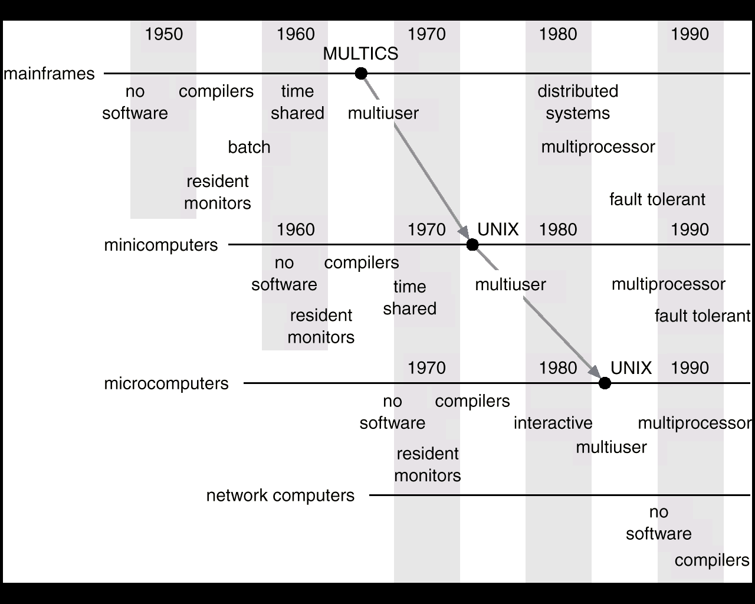
Migration of Operating-System Concepts and Features
Operating System Concepts

Slide 33
Computer System Operation
A modern general-purpose computer system consists of one or more CPUs and a number of device controllers connected through a common bus that provide access to shared memory.
Each device controller is in charge of a specific device.
The CPU and the device controllers can execute concurrently, competing for the memory cycles.
To ensure orderly access to the shared memory, a memory controller is provided whose function is to synchronize access to the memory.
I/O devices and the CPU can execute concurrently.
Each device controller has a local buffer.
CPU moves data from/to main memory to/from local buffers
Device controller informs CPU that it has finished its operation by causing an interrupt.

Slide 34

A modern computer system

Slide 35
Continue…
For example, for a computer to start running………..
  bootstrap program is loaded at power-up or reboot
    Typically stored in ROM or EEPROM, generally known as firmware
    Initializes all aspects of system
    Loads operating system kernel and starts execution

Slide 36
Computer System Operation
After loading, the operating system starts executing the first process, such as “init” and waits for some event to occur.
  The occurrence of an event is usually signaled by an interrupt from either the hardware or the software.
  Hardware may trigger an interrupt at any time by sending a signal to the CPU, usually by way of the system bus
  Software may trigger an interrupt by executing a special operation called a system call (also called a monitor call)
  When the CPU is interrupted, it stops what it is doing and immediately transfer execution to a fixed location.
    The fixed location usually contains the starting address where the service routine for the interrupt is located.
    The interrupt service routine executes; on completion, the CPU resumes the interrupted computation.

Slide 37
Computer System Operation
(Handling Interrupt)
Interrupt is an important part of computer architecture.
Incoming interrupts are disabled while another interrupt is being processed to prevent a lost interrupt.
A trap is a software-generated interrupt caused either by an error or a user request.
An operating system is interrupt driven.
The interrupt must transfer control to the appropriate service routine.,
  The straightforward method for handling this transfer would be to invoke a generic routine to examine the interrupt information; the routine, in turn would call the interrupt-specific handler.
  The interrupt architecture must also save the address of the interrupted instruction.
  After the interrupt is serviced, the saved return address is loaded into the program counter and the interrupted computation resume as though the interrupt had not occurred.

Slide 38
Storage Structure
Memories can be classified into three types:
Internal Processor Memory
Main Memory
Secondary Memory
Computer programs must be in main memory (RAM) to be executed.
Main memory is the only large storage area that the processor can access directly.
A typical instruction-execution cycle as executed on a system is:
  First processor fetches an instruction from the main memory and stores that in the instruction register.
  The instruction is then decoded and may cause operands to be fetched from memory and stored in some internal register.
  After the instruction on the operand to be executed, the result may be stored back in memory.

Slide 39
Continue…
The two key features of RAM are:
  RAM is usually too small to store all needed programs and data permanently.
  RAM is a volatile storage device that loses its contents when power is turned off.
Therefore, most computer system provides secondary memory as an extension of main memory.
  The main requirement of secondary storage is to hold a large amount of data permanently.
  The most common secondary storage device is magnetic disk.

Slide 40
Storage Hierarchy
Storage systems organized in hierarchy according to:
  Speed
  Cost
In addition to differing in speed and cost, the various storage systems are either volatile or nonvolatile.
An electronic disk can be designed to be either volatile or nonvolatile.
  During normal operation, the electronic disk stores data in a large DRAM array, which is volatile.
  But many electronic-disk devices contain a hidden magnetic hard disk and a battery for back up power.
  If external power is interrupted, the electronic-disk controller copies the data from RAM to the magnetic disk
  When external power is restored, the controller copies the data back into the RAM.
  Another form of electronic disk is flash memory, which is popular in cameras and PDAs

Slide 41

Storage-Device Hierarchy

Slide 42
Caching
Information in use copied from slower to faster storage temporarily
Faster storage (cache) checked first to determine if information is there
  If it is, information used directly from the cache (fast)
  If not, data copied to cache and used there
Cache smaller than storage being cached

Slide 43

Performance of Various Levels of Storage
Movement between levels of storage hierarchy can be explicit or implicit

Slide 44
Compute System Architecture
Single processor System
Multiprocessor system
Clustered system
Operating System Concepts

Slide 45
Single Processor System
Most systems use a single processor.
On a single processor system, there is one main CPU capable of executing a general-purpose instruction sets including instructions from user processes.
Almost all devices have other special purpose processors, such as disk, keyboard and graphic controllers
All of these special-purpose processors run a limited instruction set and do no run user processes. For example, PCs contain a microprocessor in the keyboard to convert the keystrokes into code to be sent to the CPU.

Slide 46
Multiprocessor Systems
Multiprocessor systems (also known as parallel or tightly coupled system) with more than one CPU in close communication.
Here, processors share memory and a clock; communication usually takes place through the shared bus.
Advantages of parallel system:
  Increased throughput:
    By increasing the no. of processors, we expect to get more work done in less time.
  Economical:
    Multiprocessor systems can cost less than equivalent multiple single processor system because they can share peripherals, mass storage and power supplies.
Operating System Concepts

Slide 47
Continue…
Increased reliability:
  If functions can be distributed properly among several processors, then the failure of one processor will not halt the system, only slow it down.
    graceful degradation: The ability to continue providing service proportional to the level of surviving hardware is called graceful degradation. The system designed for graceful degradation is called Fault tolerant system.
Continue operation in the presence of failure requires a mechanism to allow the failure to be detected, diagnosed and if possible, corrected.
The Tandem system uses both hardware and software duplication to ensure continued operations despite failure.
The system consists of two identical processors, each with its own local memory.
The processors are connected by bus. One processor is the primary and the other is the back up.

Slide 48
Continue…
Two copies are kept in each processors.
At fixed check point of execution of the system, the state of information of each job---including the copy of memory image is copied from primary to back up processor.
If any failure detected, the back up copy is activated and restarted from the most recent check out point.
Operating System Concepts
Notes:
ct

Slide 49
Multiprocessor Systems (Types)
Symmetric multiprocessing (SMP)
  Each processor runs an identical copy of the operating system and these copies communicate with one another as needed.
  Many processes can run at once without performance deterioration.
  All processors are peers; no master-slave relationship exists between processors.
  Most modern operating systems support SMP
Asymmetric multiprocessing
  Each processor is assigned a specific task; master processor schedules and allocates work to slave processors.
  More common in extremely large systems
Operating System Concepts

Slide 50

Symmetric Multiprocessing Architecture
Operating System Concepts

Slide 51
Clustered System
Clustered system gathers together multiple CPUs to accomplish computational work.
They are different from parallel system in that they are composed of two or more individual systems coupled together.
Clustering is usually performed to provide high availability.
A layer of cluster software runs on the cluster nodes, each node can monitor one or more of the others (over the LAN).
If the monitored machine fails, the monitoring machine can take ownership of its storage and restart the application that was running on the failed machine.
The failed machine may remain down but the users and clients of the application would only see a brief interruption of service
Operating System Concepts

Slide 52
Clustered System (Type)
Asymmetric Clustering:
  One machine is in hot-standby mode while the other is running the applications. The hot-standby host machine does nothing but monitor the active server. If the server fails, the hot-standby host becomes the active server.
Symmetric Clustering:
  In symmetric clustering, two or more hosts are running applications and are monitoring each other. This mode is more efficient as it is used all the available hardware.

Slide 53
Operating-System Operations
Modern operating systems are interrupt driven.
Events are almost always signaled by the occurrence of an interrupt or a trap.
A trap is a software-generated interrupt caused either by an error or by a specific request from a user program that an operating system service be performed.
  Division by zero, request for operating system service
Since the operating system and the users share the hardware and software resources of the computer system, we need to make sure that an error in a user program could cause problems only for the one program that was running.
More subtle errors can occur in a multiprogramming system, where one erroneous program might modify another program, the data of another program or even the operating system itself.
A properly designed OS must ensure that an incorrect program cannot cause other programs to execute incorrectly.

Slide 54
Dual-Mode Operation
Dual-mode operation allows OS to protect itself and other system components
  User mode and kernel mode
  Mode bit provided by hardware
    Provides ability to distinguish when system is running user mode (mode1) or kernel mode (mode 0)
    When the computer system is executing on behalf of a user application, the system is in user mode.
    When a user application request a service from the operating system (via a system call), it must transition from user to kernel mode to fulfill the request.
    Some instructions designated as privileged, only executable in kernel mode. If an attempt is made to execute a privileged instruction in user mode, the hardware treats is as illegal and traps it to the OS.
Operating System Concepts

Slide 55
Continue…
At system boot time the hardware starts in kernel mode.
The OS is then loaded and starts user applications in user mode.
Whenever a trap or interrupt occurs, the hardware switches from user mode to kernel mode.
Whenever the OS gains control of the computer, it is in kernel mode.
The system always switches to user mode (by setting the mode bit to 1) before passing control to a user program.
Eventually, control is switched back to the operating system via an interrupt, a trap or a system call.
Operating System Concepts

Slide 56

Transition from User to Kernel Mode
The lack of a hardware supported mode can cause serious shortcoming in an operating system.
MS-DOS was written for the Intel 8088 architecture, which has no mode bit and therefore a user program running away can wipe out the operating system by writing over it with data.

Slide 57
Timer
We must prevent a user program from getting stuck in an infinite loop or not calling system services and never returning control to the OS.
We can user a Timer.
Timer to prevent infinite loop / process hogging resources
  Set interrupt after specific period (may be fixed or variable)
  A variable-timer is generally implemented by a fixed-rate clock and a counter.
  The OS sets the counter.
  Operating system decrements counter every time the clock ticks.
  When counter reaches to zero, it generates an interrupt
  Before turning control to the user, the OS ensures that the timer is set to interrupt.
Operating System Concepts

Slide 58
Distributed System
A distributed system is a collection of physically separated, possibly heterogeneous computer system, that are networked to provide the users with access to the various resources that the system maintains.
Access to the shared resources increases computational speed, functionality, data availability and reliability.
Distributed systems depend on networking for their functionality.

Slide 59

Computing Environments
(Client-Server Computing)
  One model of distributed system.
  Many systems now servers, responding to requests generated by clients.
    Compute-server provides an interface to client to request services (i.e. database)
    File-server provides interface for clients to store and retrieve files

Slide 60
Peer-to-Peer Computing
Another model of distributed system
P2P does not distinguish clients and servers
  Instead all nodes are considered peers
  May each act as client, server or both
  To participate in a peer-to-peer system, a node must first join the network of peer.
  Once a node has joined the network, it can begin providing services to—and requesting services from--- other nodes in the network.
  When a node joins a network, it registers its service with a centralized lookup service on the network. Any node desiring a specific service first contacts this centralized lookup service to determine which node provides the service.
  The peer acting as a client must first discover what node provides a desired service by broadcasting a request for the service to all other nodes in the network. The node providing the service responds to the peer. For this a discovery protocol must be applied that allows peers to discover services provided by other peers in the network.
  Examples include Napster and Gnutella

Slide 61
End of Chapter 1

